Slide 1

USACO Bronze Week 7

Slide 2

Content of this session
String ops - answers to PythonChallenge Level 10 (Look and Say Sequence)
Basic Sorting (brief!)
Practice Exam

Slide 3
Answers to PythonChallenge - Look and Say Sequence (C++)
#include <iostream>
using namespace std;
string lookAndSay(string s)
{
string ans = "";
int count = 0;
for(int i = 0; i < s.length(); i++)
{
//check if we've finished a "block of numbers"
if(i >= 1 && s[i] != s[i-1])
{
//append previous sequence
//format: [# of occurances of x, then x]
ans += to_string(count);
ans += s[i-1];
//start a new string by resetting counter
count = 0;
}
count++;
}
//append the last block
ans += to_string(count);
ans += s[s.length()-1];
return ans;
}
int main()
{
string s = "1";
for(int i = 0; i < 31; i++)
{
cout << s.length() << '\n';
s = lookAndSay(s);
}
return 0;
}
Problem Statement
Look and say: a = [“1”, “11”, “21”, “1211”, “111221”, …]
What is len(a[30]); i.e. what’s length of 31st element of look and say sequence?
Solution:
LINK: http://www.pythonchallenge.com/pc/return/bull.html
Username: huge
Password: file
Run the code on the right, and at the last line you get a length for the 31st element, i.e. len(a[30]) = 5808.
Then go to http://www.pythonchallenge.com/pc/return/5808.html
Tada! You are now at Level 11. (Level 11 is image processing and separation of image channels, which is beyond the scope of this course!!!)
Notes - Java implementation should be similar. Remember to reference a string with charAt(), not []. Also, to_string will not work - find an appropriate substitute.

Slide 4
USACO Class 4 Google Classroom
Go to Google Classroom, Login to your account.
https://classroom.google.com/h
Add class.
Class Code:
c9oh3in

Slide 5
Sorting - Bubble Sort
https://www.youtube.com/watch?v=P00xJgWzz2c
7 | 1 | 4 | 2 | 3 | 6
1 | 7 | 4 | 2 | 3 | 6
1 | 4 | 7 | 2 | 3 | 6
1 | 4 | 2 | 7 | 3 | 6
1 | 4 | 2 | 3 | 7 | 6
1 | 4 | 2 | 3 | 6 | 7

Slide 6
Sorting - Bubble Sort
https://www.youtube.com/watch?v=P00xJgWzz2c
1 | 4 | 2 | 3 | 6 | 7
1 | 4 | 2 | 3 | 6 | 7
1 | 2 | 4 | 3 | 6 | 7
1 | 2 | 3 | 4 | 6 | 7
1 | 2 | 3 | 4 | 6 | 7
1 | 2 | 3 | 4 | 6 | 7

Slide 7
Sorting - Bubble Sort
Each time you compare with the neighbor and finally pop the largest one to the top.
Continue doing this for n-1 times, then the array will be sorted.
1 | 2 | 3 | 4 | 6 | 7

Slide 8
Sorting - Selection Sort
https://www.youtube.com/watch?v=6nDMgr0-Yyo
7 | 1 | 4 | 2 | 3 | 6
7 | 1 | 4 | 2 | 3 | 6
1 | 7 | 4 | 2 | 3 | 6

Slide 9
Sorting - Selection Sort
https://www.youtube.com/watch?v=6nDMgr0-Yyo
1 | 7 | 4 | 2 | 3 | 6
1 | 7 | 4 | 2 | 3 | 6
1 | 2 | 4 | 7 | 3 | 6

Slide 10
Sorting - Selection Sort
https://www.youtube.com/watch?v=6nDMgr0-Yyo
1 | 2 | 4 | 7 | 3 | 6
1 | 2 | 4 | 7 | 3 | 6
1 | 2 | 3 | 7 | 4 | 6

Slide 11
Sorting - Selection Sort
https://www.youtube.com/watch?v=6nDMgr0-Yyo
1 | 2 | 3 | 7 | 4 | 6
1 | 2 | 3 | 7 | 4 | 6
1 | 2 | 3 | 4 | 7 | 6

Slide 12
Sorting - Selection Sort
Each time select the smallest one in the unsorted array, and swap with the first unsorted element.
1 | 2 | 3 | 4 | 7 | 6
1 | 2 | 3 | 4 | 7 | 6
1 | 2 | 3 | 4 | 6 | 7

Slide 13
Sorting - Insertion Sort
https://www.youtube.com/watch?v=c4BRHC7kTaQ
7 | 1 | 4 | 2 | 3 | 6
1 | 7 | 4 | 2 | 3 | 6
1 | 4 | 7 | 2 | 3 | 6
1 | 2 | 4 | 7 | 3 | 6
1 | 2 | 3 | 4 | 7 | 6
1 | 2 | 3 | 4 | 6 | 7

Slide 14
Sorting - Quick Sort
https://www.youtube.com/watch?v=y_G9BkAm6B8
7 | 1 | 4 | 2 | 3 | 6
7 | 1 | 4 | 2 | 3 | 6
3 | 1 | 4 | 2 | 7 | 6
3 | 1 | 2 | 4 | 7 | 6
3 | 1 | 2 | 4 | 7 | 6

Slide 15
Sorting - Quick Sort
https://www.youtube.com/watch?v=y_G9BkAm6B8
3 | 1 | 2 | 4 | 7 | 6
3 | 1 | 2 | 4 | 7 | 6
2 | 1 | 3 | 4 | 6 | 7
1 | 2 | 3 | 4 | 6 | 7

Slide 16
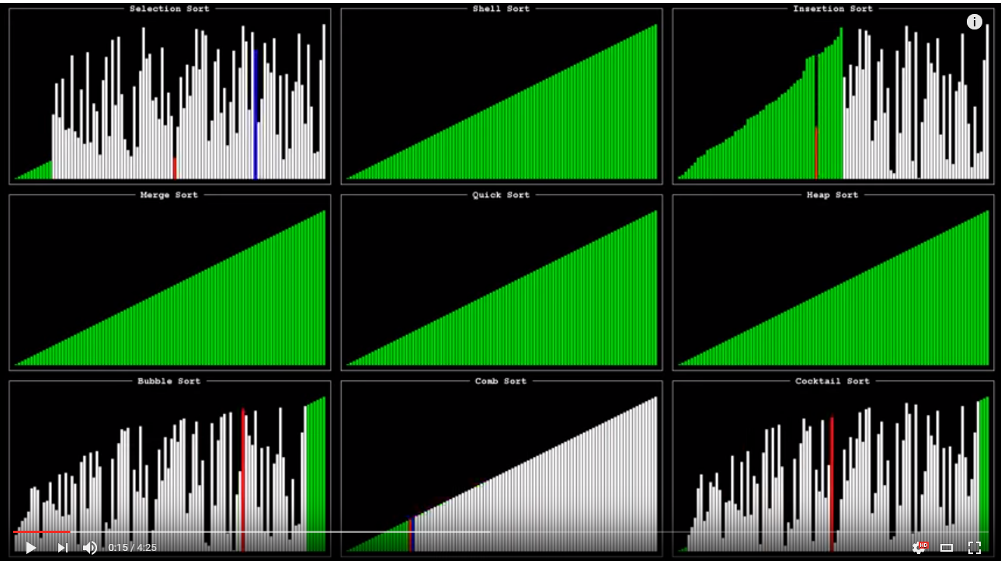
Sorting - Which one is faster?
https://www.youtube.com/watch?v=ZZuD6iUe3Pc

Slide 17
Sort - Complexity
Typically, in C++ and Java, sorting is done with QuickSort (MergeSort and QuickSort for Java).
Insertion sort, Selection Sort, and Bubble Sort are all O(N²) (order of N*N operations), where as QuickSort/MergeSort are O(N log(N)) (order of N*log(N) operations)
This means for sorting, you should sort no more than ~ 10⁶ to 10⁷ objects in order to fit WITHIN the 2 second time constraint (depending on your constant factor).

Slide 18
Sort - Standard Sorting
C++:
#include <algorithm>
sort(ar,ar+n); //sort an array
sort(v.begin(),v.end()); //sort a vector
Java:
import java.util.*;
Arrays.sort(ar); //sort an array
Collections.sort(v); //sort an ArrayList

Slide 19
Basic Sorting (Bronze)
Farmer John owns 7 dairy cows: Bessie, Elsie, Daisy, Gertie, Annabelle, Maggie, and Henrietta. He milks them every day and keeps detailed records on the amount of milk provided by each cow during each milking session. Not surprisingly, Farmer John highly prizes cows that provide large amounts of milk.
Cows, being lazy creatures, don't necessarily want to be responsible for producing too much milk. If it were up to them, they would each be perfectly content to be the lowest-producing cow in the entire herd. However, they keep hearing Farmer John mentioning the phrase "farm to table" with his human friends, and while they don't quite understand what this means, they have a suspicion that it actually may not be the best idea to be the cow producing the least amount of milk. Instead, they figure it's safer to be in the position of producing the second-smallest amount of milk in the herd. Please help the cows figure out which of them currently occupies this desirable position.
https://classroom.google.com/c/Njg2Nzc4Mjc5N1pa/sa/Njg2MzU3NzI3Nlpa/details

Slide 20
Homework - Practice Exam
For homework, let’s do a practice set for Bronze Level. Give yourselves 4 hours to solve three questions!!! Next week we’ll go over these problems together, so be prepared with questions to ask!
UPDATE - 10/26/19 I actually wanted you guys to do the December 2017 Bronze test (http://www.usaco.org/index.php?page=dec17results), not the Springlight OJ one. Sorry for the confusion, I forgot to update the materials for this class session.
Keep track of (a rough sense of) time while you solve these problems. Don’t worry if you don’t finish all the problems in class - you can continue them after class if you wish to do so (again, keeping track of time), and we can discuss them afterwards.
IN AN ACTUAL CONTEST
NUMBER ONE IS NOT ALWAYS THE EASIEST PROBLEM! AND NUMBER THREE IS NOT ALWAYS THE HARDEST PROBLEM!
In a real contest, budget your time!!!
Don’t spend too long on any one problem - just brute force if in doubt or skip it/come back.

